Slide 1
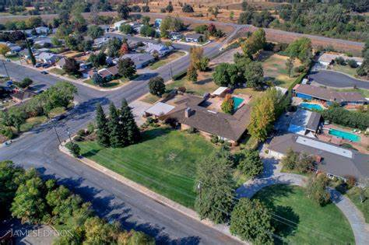


City of Marysville
EIR Scoping Meeting General Plan, Specific Plan and Zoning Code Update
March 16, 2021
Notes:
Good evening- I’m Kathy Pease a planning consultant and with me this evening via zoom is Nicole West with PlaceWorks, the consultant that prepared the Draft Housing Element.

Slide 2

Agenda
Introductions
  Kristina Heredia, Assistant Community Development Director
  Kathy Pease, Contract Planner
Purpose of Scoping Meeting
Project Overview
Purpose of California Environmental Quality Act (CEQA)
EIR Process
Topics to be Analyzed
Public Comment
This Photo by Unknown Author is licensed under CC BY-SA-NC

Slide 3

Purpose of Scoping Meeting
  Provide opportunity for the public regarding the “scope” of the EIR
  • Identify topics for analysis
  • Potential mitigation measures to reduce impacts
  • Potential project alternatives
» What the meeting is not:
  • Public Hearing
  • Last opportunity for feedback
  • Decision on the project

Slide 4

Project Overview

Slide 5
General Plan Update-2050
City’s blueprint or vision for future growth and development
• Must contain at least eight elements, others can be added
High level policy document
  Last comprehensively updated in 1983
  Usually updated every 10-20 years.
  Long range document covering a 20-year timeframe.

Slide 6

General Plan Update-2050
Long range document covering 20-year timeframe
City’s blueprint or vision for future growth and development
Must contain at least eight elements, others can be added
High level policy document
  Last comprehensively updated in 1983
  .
11

Slide 7
Downtown Specific Plan
Planning and regulatory tool intended to implement the general plan through the development of policies, programs and regulations which provide an intermediate level of detail between the general plan and individual development projects.
  Ellis Lake
  E Street Corridor
  Downtown Commercial Core
  Medical Arts District
11

Slide 8
Zoning Code Update
Streamline development
Update consistent with recent state law requirements
(i.e., accessory dwelling units, affordable housing etc.).
11

Slide 9
What is CEQA
Requires public agencies to consider environmental consequences of discretionary actions before approving plans, policies, or projects
Disclose project impacts to public and decision makers
Foster inter-agency coordination and review
Identify ways to avoid or reduce environmental impacts
11

Slide 10
Regional Housing Needs Allocation (RHNA)
Income Category | RHNA | Zoning
Lower Income: < 80% of Median Income | 61 units | PD, R-3, R-4, M-1, C-2, C-3
Moderate Income: 81-120% of Median Income | 31 units | PD, R-3, C-2 and C-3
Above Moderate Income: >120% of Median Income | 75 units | PD, R-1, R-2, R-3
TOTAL | 167 units
Median household income, 2018
Marysville: $47,448 (80% = $37,958)
Yuba County: $52,624 (80% = $42,099)
Notes:
Each jurisdiction is provided a portion of the region’s housing units to accommodate its share of what is called the regional housing needs allocation or RHNA for short. This information is based on a formula determined by the Sacramento Area Council of Governments or SACOG. Marysville’s RHNA is 167 units as shown on this slide and split between three income targets.
Each jurisdiction is provided a portion of the region’s housing units to accommodate its share of what is called the regional housing needs allocation or RHNA for short. This information is based on a formula determined by the Sacramento Area Council of Governments or SACOG. SACOG’s formula takes into consideration growth rate, income, jobs and other factors to come up with the jurisdictions number. Marysville’s RHNA is 167 units as shown on this slide which is split between low income moderate income and above moderate income targets.
5th Cycle LOWER MOD ABOVE MOD
RHNA 20 13 39
Realistic units 266 142 37
Talk in potential acres: 61 units at 20 units an acre is about 3 acres

Slide 11
Ability to Meet RHNA
 | Total Units | Affordability level
 |  | Lower | Mod | Abv. Mod
RHNA | 167 | 61 | 31 | 75
ADUs anticipated | 8 | 4 | 4 | 0
Remaining RHNA Subtotal | 159 | 57 | 27 | 75
Vacant Inventory | 340 | 75 | 126 | 139
Surplus | 181 | 18 | 99 | 64
Notes:
The good news is that although Marysville has limited opportunities for growth, there are adequate remaining vacant sites within the City to accommodate the RHNA.

Slide 12

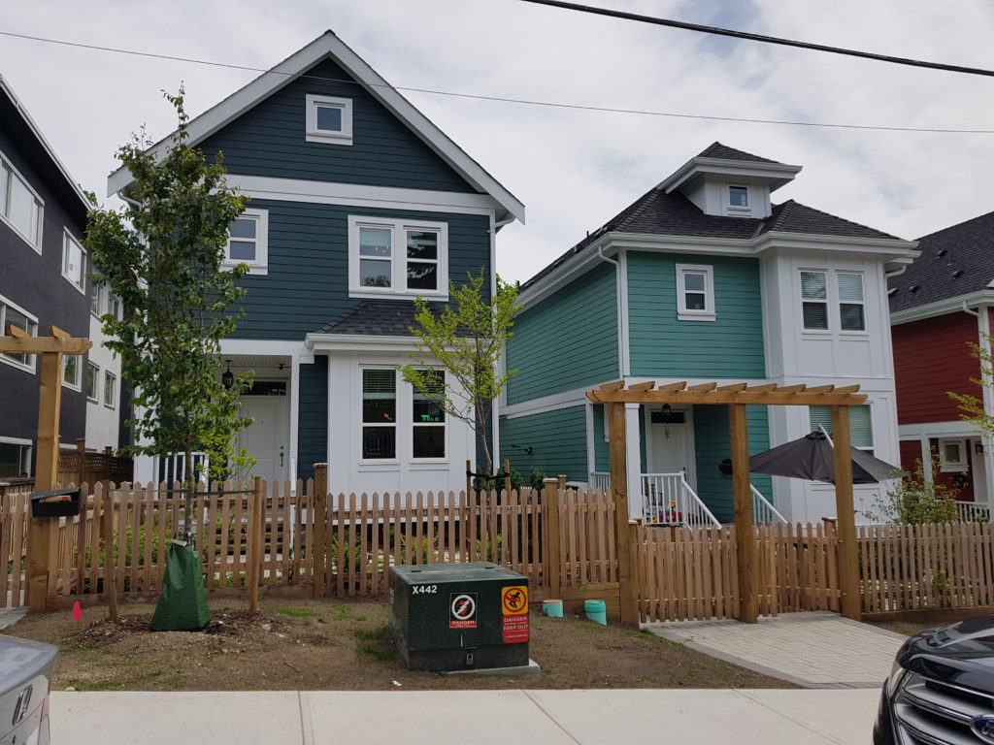
New or Updated Information
Updated Demographic Information
Identification of Vacant Sites to Meet RHNA
Address New State Laws
Minor Technical Updates
This Photo by Unknown Author is licensed under CC BY-NC-ND
This Photo by Unknown Author is licensed under CC BY-SA
Notes:
The Draft Housing Element was made available to the public on February 12 when it was posted to the City’s website. The Update includes updated data, identification of vacant sites to meet the RHNA, information to address new state laws as well as minor technical updates. information includes continuation of the prior programs, incorporated the City’s 2015 Bounce Back Vision and Implementation Plan,

Slide 13
Public Review Draft Housing Element
  Continuation of the prior programs, plus:
  Implement 2015 Marysville Bounce Back Vision & Implementation Plan
  Incorporate Commissions recommendations from November 16, 2020 Workshop
      Encourage microunits in mixed-use designs
      Collaborate with interested investors on solutions to obtaining financing for legally nonconforming multifamily buildings
Notes:
The document also responds to updated state law which requires residential uses by right where multifamily and mixed uses are permitted, as well as policies to streamline housing.
Other updated information includes continuation of the prior programs, incorporated information on the 2015 Bounce Back Vision and Implementation Plan, information from the Commission’s recommendations at the November 16th Housing Element workshop, such as encouraging mcro units in mixed use design and collaborate with interested investors on solutions to obtaining financing for legally non conforming multi family buildings.
I am now going to turn the presentation over to Nicole to talk a little bit more about the new requirements.

Slide 14
Address New State Laws
    Update zoning to allow low-barrier navigation center, transitional and supportive housing in all zones where multifamily and mixed uses are permitted
    Establish policy or procedure for SB 35 streamlining approval process
Notes:
There are requirements that the Housing Element now analyze fair housing, which prohibits discrimination in home sales, financing, and rentals.
The document also responds to updated state law which requires residential uses by right where multifamily and mixed uses are permitted, and policies to stream line housing.

Slide 15
Affirmatively Address Fair Housing
    Comply with fair housing laws
    Collaboration with California Rural Legal Assistance
    Education, outreach and staff training
    Encourage multifamily housing in high opportunity areas
    Address barriers to fair housing and housing choice
    Proactive rehabilitation and code enforcement
    CDBG-funded infrastructure improvements in lower resource areas

Slide 16
Next Steps

Slide 17
Schedule
November 2020: Planning Commission Public Workshop
February 2021: Public Review Draft Housing Element Available
February 24, 2021: Planning and Historic Preservation Commission
March 16, 2021: City Council
March 2021: Submit to HCD for review (60-days)
June 23, 2021: Planning and Historic Preservation Commission:
July 20,2021: City Council
.
Notes:
Next steps include submitting the Draft Housing Element to the State for review which is a 60-day review period. Any recommended edits will be incorporated and the Draft Document will be brought back to the Commission in June and potential adoption by the city council in July.

Slide 18
Safety Element and Environmental Justice
New law requires the Safety Element and Environmental Justice sections of the General Plan be updated at the time the Housing Element is updated
Currently being drafted
No mandatory review or adoption date
Expect to have Draft for City Council review later this year.
Notes:
I wanted to mention that the Safety Element will be updated.

Slide 19
Recommendation
City Council submit the Housing Element to the HCD for review
Notes:
As the Housing Element reviewing authority, HCD has the discretion to forward a Housing Element compliance issues to the Attorney General. The Attorney General may then obtain a court order, and if the jurisdiction does not comply, the following penalties apply:
An initial penalty of between $10,000 and $100,000 per month.
Triple the initial penalty, if the jurisdiction does not comply within three months of the first penalty.
Six times the initial penalty, if the jurisdiction does not comply within six months of the first penalty. Most critically, the court may also appoint a receiver with all powers necessary to bring the jurisdiction into compliance. This means that the jurisdiction loses local planning and land use discretion, and a compliant Housing Element will be developed and imposed by the state with no input by the local agency.
This is why Housing Element compliance is so important.

Slide 20
How to Provide Additional Input
Provide Written Comments:
City of Marysville
Community Development Department
P.O. Box 150
Marysville, CA 95901
Get on Mailing List for updates
Call: (530) 749-3902
Email: Kathy Pease, Contract Planner at: kpease@masfirm.com
Notes:
In conclusion the public is invited to submit comments or reach out by calling the City or emailing me. Thank you.

